Slide 1
Course Title: Data Mining
Course Code: PM-ASDS 18
Lecture-10 & 11: Neural Network
(13.12.2024 & 20.12.2024)
Presented by
Nasrin Khatun
Assistant Professor
Department of Statistics
Jahangirnagar University

Slide 2
Neural Network
Artificial Neural Network:
An Artificial Neural Network (ANN) is a mathematical model that tries to simulate the structure and functionalities of biological neural networks.
Basic building block of every artificial neural network is artificial neuron, that is, a simple mathematical model (function).
Such a model has three simple sets of rules: multiplication, summation and activation.

Slide 3
Neural Network
Artificial Neural Network:
At the entrance of artificial neuron the inputs are weighted what means that every input value is multiplied with individual weight.
In the middle section of artificial neuron is sum function that sums all weighted inputs and bias.
At the exit of artificial neuron the sum of previously weighted inputs and bias is passing through activation function that is also called transfer function.

Slide 4
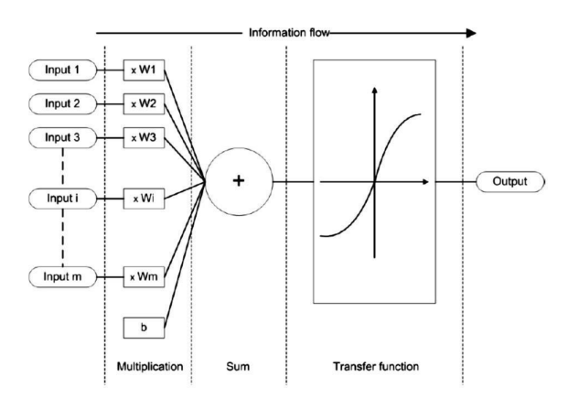
Artificial Neural Network
Graphical plot of ANN

Slide 5
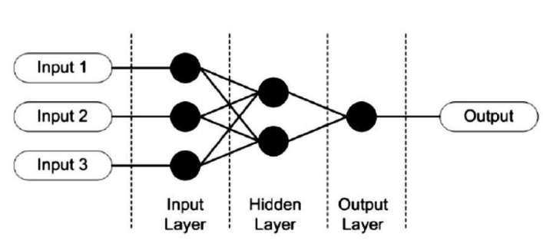
Artificial Neural Network
Graphical plot of ANN (Single)

Slide 6
Artificial Neural Network
Graphical plot of ANN (Single)
x₁
X₁
w₁
Y
y
x₂
w₂
X₂

Slide 7
Artificial Neural Network
Graphical plot of ANN (Single)
x₁
X₁
w₁
Y
y
x₂
w₂
X₂

Slide 8
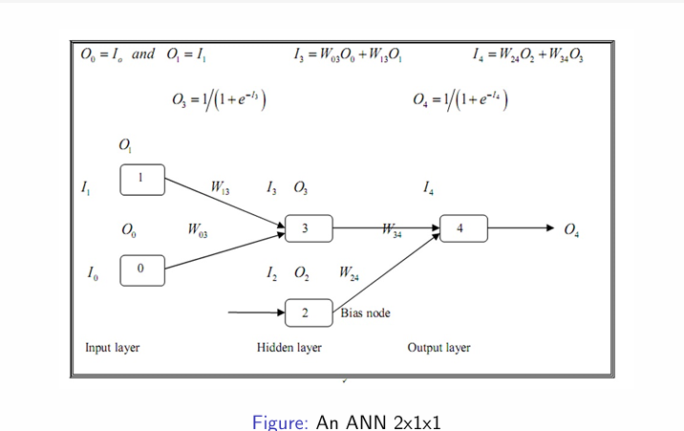
Artificial Neural Network
Graphical plot of ANN

Slide 9
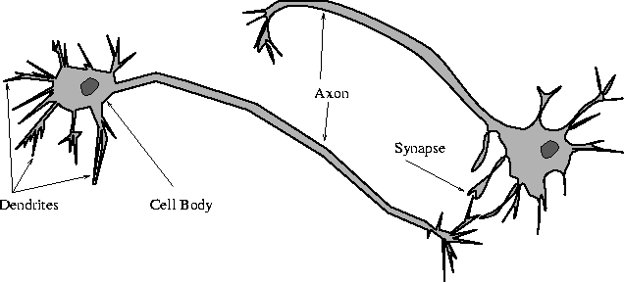
Biological Neural Network
Graphical plot

Slide 10
Artificial Neural Network
ANN
The ANN can be constructed using the following steps:
Determining the structure of ANN
Divide the input data and output data into two groups,
Scale the input variables
Set initial weights and start a training epoach
Input scale variable.
Distribute the scale input
Weight and Sum inputs to receiving nodes.
Transform hidden-node inputs to outputs.

Slide 11
Artificial Neural Network
ANN
The ANN can be constructed using the following steps:
9. Weight and sum hidden node outputs as inputs to the output nodes.
10. Transform inputs at the output nodes.
11. Calculate Output Errors.
12. Backpropagate errors to adjust weights.
13. Continue the epoch.
14. Calculate the epoch RMS
15. Judge out-of-sample validity.
16. Use the model in forecasting.

Slide 12
Artificial Neural Network
Applications of ANNs
The several different types of application of Artificial Neural Networks include the following:
Classification problems consist of credit approval processes (i.e.,
acceptance or rejection) and defect identification (i.e., good or
defective).
Mathematical modelling occurs when the ANN is used to identify or emulate a mathematical function.
Forecasting and prediction includes univariate or multivariate forecasting application.

Slide 13
Artificial Neural Network
ANN: Applications of ANNs
Reconstruction or Recognition involves identifying a pattern in noisy or unclear signal. For example, character recognition applications are indicative of reconstruction. The character recognition methods in computer scanners and fax board use ANNs.
Clustering involves finding logical groupings of values in data- for example in marketing, when trying to group types of consumer and their responses to different types of promotions.
Routing consists of determining the best route through a number of destinations, the traveling salesman problem being an example.
As mentioned, the ANN approach that is most relevant to forecasting is a back propagation method.

Slide 14
Artificial Neural Network
ANN:
There are many advantages to the use of NNs for classification:
NNs are more robust than DTs because of the weights.
• The NN improves its performance by learning. This may continue even after the training set has been applied.
• The use of NNs can be parallelized for better perfomance.
• There is a low error rate and thus a high degree of accuracy once the appropriate training has been performed.
• NNs are more robust than DTs in noisy environments.

Slide 15
Artificial Neural Network
ANN:
There are many dis-advantages to the use of NNs for classification:
• NNs are difficult to understand. Nontechnical users may have difficulty understanding how NNs work. While it is easy to explain decision trees, NNs are much more difficult to understand.
• Generating rules from NNs is not straightforward.
• Input attribute values must be numeric.
• Testing
• Verification
• As with DTs, overfitting may result.
• The learning phase may fail to converge.
• NNs may be quite expensive to use.

Slide 16
Activation Function
What is activation function?
An Activation Function decides whether a neuron should be activated or not.
It will decide whether the neuron’s input to the network is important or not.
This whole process can be done using a simpler mathematical operations known as activation function.

Slide 17
Activation Function
Purpose of activation function
To derive output from a set of input values fed to a node (or a layer).
To add non-linearity to the neural network.
NODE
By comparing the neural network to our brain, a node is a replica of a neuron that receives a set of input signals—external stimuli.

Slide 18
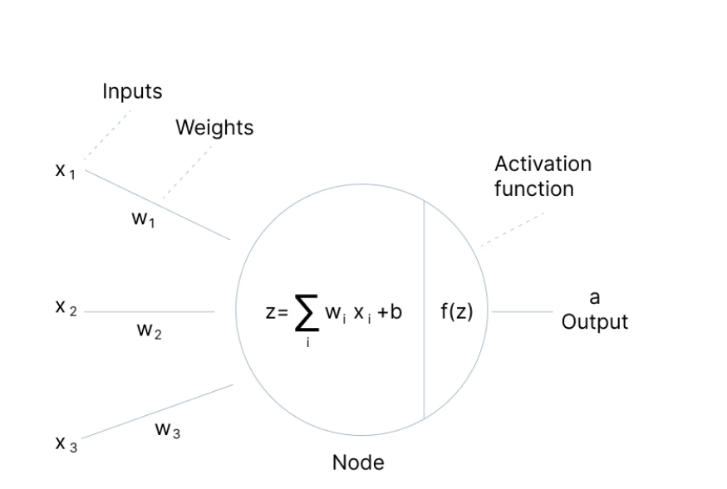
Activation Function
Different components of NN:

Slide 19
Activation Function
Different components:
Input Layer
The input layer takes raw input from the domain. No computation is performed at this layer. Nodes here just pass on the information (features) to the hidden layer.
Hidden Layer
The nodes of this layer are not exposed. They provide an abstraction to the neural network. The hidden layer performs all kinds of computation on the features entered through the input layer and transfers the result to the output layer.
Output Layer
It’s the final layer of the network that brings the information learned through the hidden layer and delivers the final value as a result.

Slide 20
Activation Function
Movements of information:
Inputs, weights, bias, and nodes or layers can be moved into activation function and then finding outputs into tow ways:
Feedforward and
Backpropagation

Slide 21
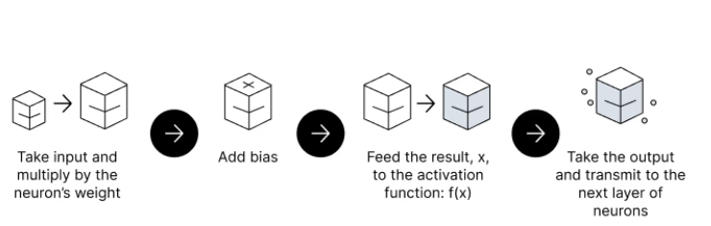
Activation Function
Movements of information:
Feedforward:
The flow of information occurs in the forward direction. The input is used to calculate some intermediate function in the hidden layer, which is then used to calculate an output.
The Activation Function is a mathematical “gate” in between the input feeding the current neuron and its output going to the next layer.

Slide 22
Activation Function
Movements of information:
Backpropagation:
The weights of the network connections are repeatedly adjusted to minimize the difference between the actual output vector of the net and the desired output vector.
It aims to minimize the cost function by adjusting the network’s weights and biases. The cost function gradients determine the level of adjustment with respect to parameters like activation function, weights, bias, etc.

Slide 23
Types of Linear Activation Function
Binary Step Function
Binary step function depends on a threshold value that decides whether a neuron should be activated or not.
The input fed to the activation function is compared to a certain threshold; if the input is greater than it, then the neuron is activated, else it is deactivated, meaning that its output is not passed on to the next hidden layer.

Slide 24
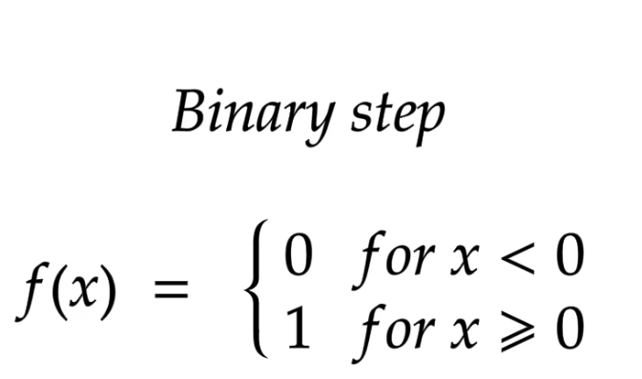
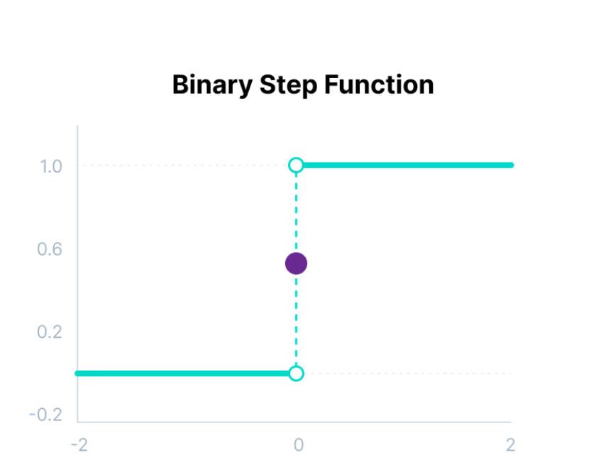
Activation Function
Binary Step Function

Slide 25
Activation Function
Limitations of Binary Step Function
It cannot provide multi-value outputs—for example, it cannot be used for multi-class classification problems.
The gradient of the step function is zero, which causes a hindrance in the backpropagation process.

Slide 26
Activation Function
Linear Step Function
The linear activation function, also known as "no activation," or "identity function" (multiplied x1.0), is where the activation is proportional to the input.
The function doesn't do anything to the weighted sum of the input, it simply spits out the value it was given.
Problems:
It is not possible to use backpropagation as the derivative of the function is a constant and has no relation to the input x.
All layers of the neural network will collapse into one if a linear activation function is used. No matter the number of layers in the neural network, the last layer will still be a linear function of the first layer. So, essentially, a linear activation function turns the neural network into just one layer.
It is also used for linear regression problem not for complex pattern.

Slide 27
Types of Non-Linear Activation Function
Non-Linear Activation Functions
Non-linear activation functions solve the following limitations of linear activation functions:
They allow backpropagation because now the derivative function would be related to the input, and it’s possible to go back and understand which weights in the input neurons can provide a better prediction.
They allow the stacking of multiple layers of neurons as the output would now be a non-linear combination of input passed through multiple layers. Any output can be represented as a functional computation in a neural network.

Slide 28
Types of Linear Activation Function
Linear Activation Functions
It has several types including
Sigmoid / Logistic Activation Function
Tanh Function (Hyperbolic Tangent)
ReLU Function
Leaky ReLU Function
Parametric ReLU Function
Exponential Linear Unit, or ELU
‍Softmax Function
Swish Function
Gaussian Error Linear Unit (GELU)
Scaled Exponential Linear Unit (SELU)

Slide 29
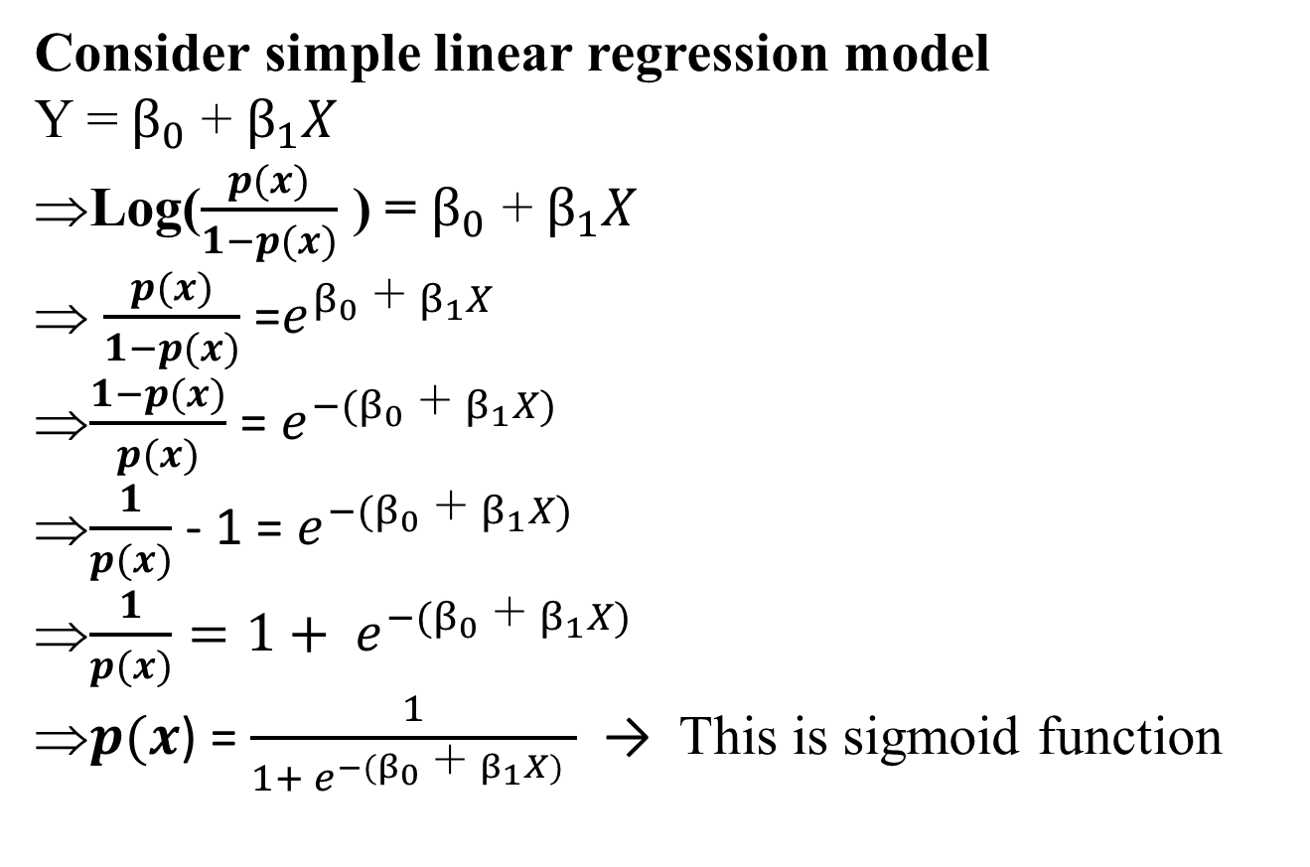
Sigmoid / Logistic Activation Function
Consider simple linear regression model
Y = $β_{0}$ + $β_{1}X$
Log($\frac{p(x)}{1−p(x)}$ ) = $β_{0}$ + $β_{1}X$
$\frac{p(x)}{1−p(x)}$ =$e^{β_{0}\text{ +} β_{1}X }$
$\frac{1−p(x)}{p(x)}$ = $e^{{−(β}_{0}\text{ +} β_{1}X) }$
$\frac{1}{p(x)}$ - 1 = $e^{{−(β}_{0}\text{ +} β_{1}X) }$
$\frac{1}{p(x)}=1+ e^{{−(β}_{0}\text{ +} β_{1}X) }$
$p(x$) = $\frac{1}{1+ e^{{−(β}_{0}\text{ +} β_{1}X) }}$ → This is sigmoid function

Slide 30
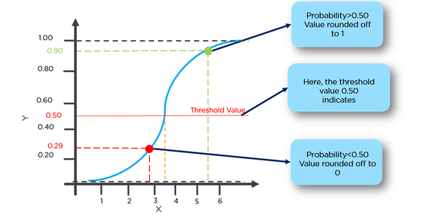
Sigmoid / Logistic Activation Function

Slide 31
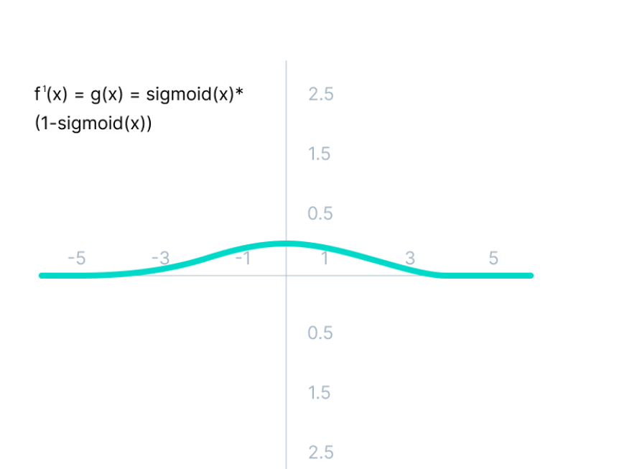
Sigmoid / Logistic Activation Function
Explanation:
This function takes any real value as input and outputs values in the range of 0 to 1.
The larger the input (more positive), the closer the output value will be to 1.0, whereas the smaller the input (more negative), the closer the output will be to 0.0, as shown below.
Limitations:
The derivative of the function is f'(x) = sigmoid(x)*(1-sigmoid(x)).

Slide 32
Sigmoid / Logistic Activation Function
Explanation:
This function takes any real value as input and outputs values in the range of 0 to 1.
The larger the input (more positive), the closer the output value will be to 1.0, whereas the smaller the input (more negative), the closer the output will be to 0.0, as shown below.
Limitations:
The derivative of the function is f'(x) = sigmoid(x)*(1-sigmoid(x)).

Slide 33
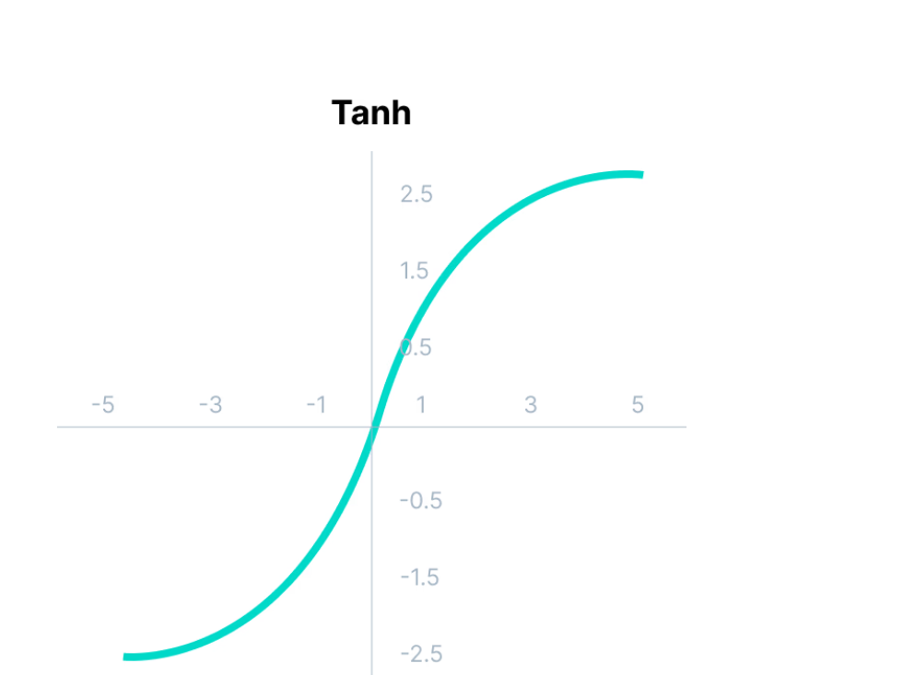
Tanh Function (Hyperbolic Tangent)
Tanh function is very similar to the sigmoid/logistic activation function, and even has the same S-shape with the difference in output range of -1 to 1.
In Tanh, the larger the input (more positive), the closer the output value will be to 1.0, whereas the smaller the input (more negative), the closer the output will be to -1.0.

Slide 34
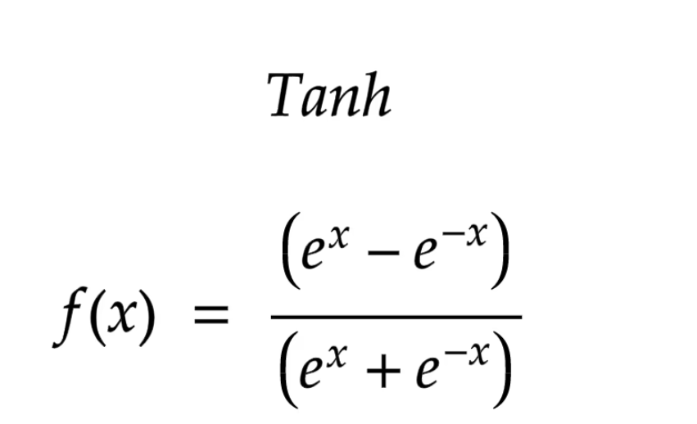
Tanh Function (Hyperbolic Tangent)
Mathematically,
Advantages:
The output of the tanh activation function is Zero cantered; hence we can easily map the output values as strongly negative, neutral, or strongly positive.
Usually used in hidden layers of a neural network as its values lie between -1 to; therefore, the mean for the hidden layer comes out to be 0 or very close to it. It helps in centering the data and makes learning for the next layer much easier.

Slide 35
Tanh Function (Hyperbolic Tangent)
Mathematically,
Advantages:
The output of the tanh activation function is Zero cantered; hence we can easily map the output values as strongly negative, neutral, or strongly positive.
Usually used in hidden layers of a neural network as its values lie between -1 to; therefore, the mean for the hidden layer comes out to be 0 or very close to it. It helps in centering the data and makes learning for the next layer much easier.

Slide 36
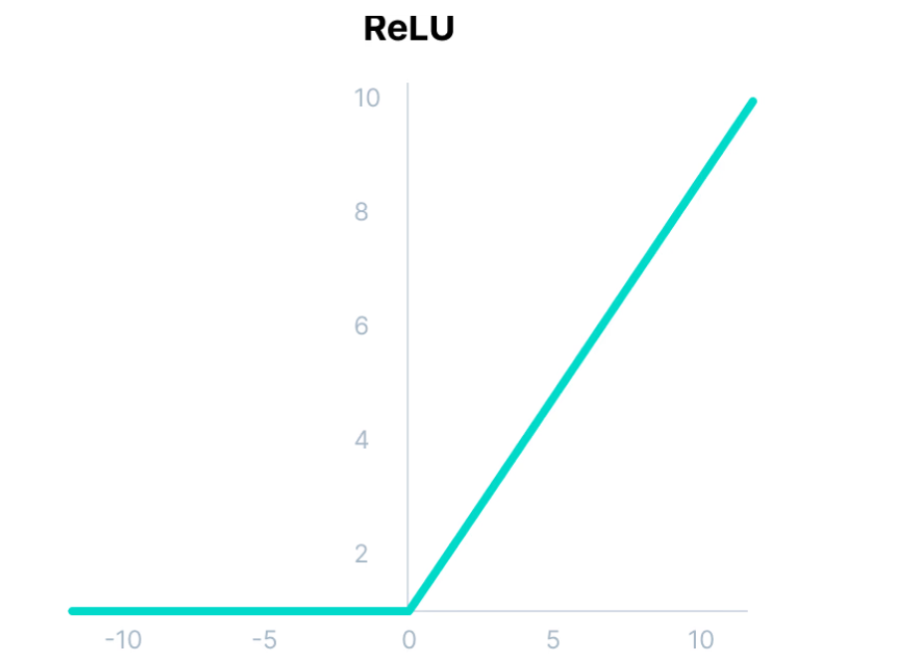
ReLU (Rectified Linear Unit)
Although it gives an impression of a linear function, ReLU has a derivative function and allows for backpropagation while simultaneously making it computationally efficient.
The main catch here is that the ReLU function does not activate all the neurons at the same time.
The neurons will only be deactivated if the output of the linear transformation is less than 0.

Slide 37
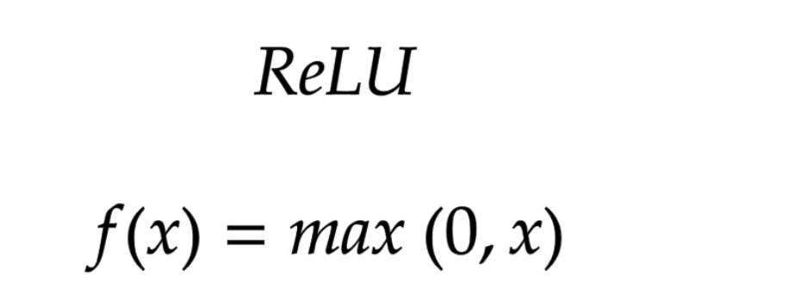
ReLU (Rectified Linear Unit)
Mathematically,
Advantages:
Since only a certain number of neurons are activated, the ReLU function is far more computationally efficient when compared to the sigmoid and tanh functions.
ReLU accelerates the convergence of gradient descent towards the global minimum of the loss function due to its linear, non-saturating property.

Slide 38
ReLU (Rectified Linear Unit)
Mathematically,
Advantages:
Since only a certain number of neurons are activated, the ReLU function is far more computationally efficient when compared to the sigmoid and tanh functions.
ReLU accelerates the convergence of gradient descent towards the global minimum of the loss function due to its linear, non-saturating property.

Slide 39
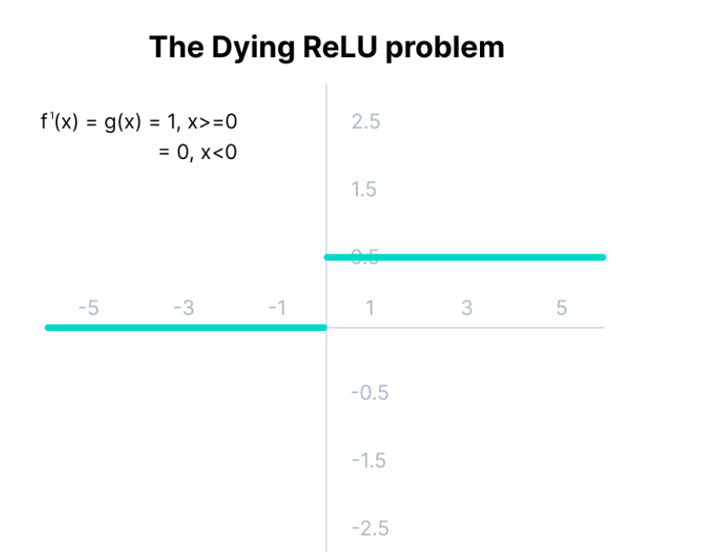
ReLU (Rectified Linear Unit)
Disadvantages: The Dying ReLU problem.
The negative side of the graph makes the gradient value zero. Due to this reason, during the backpropagation process, the weights and biases for some neurons are not updated. This can create dead neurons which never get activated.
All the negative input values become zero immediately, which decreases the model’s ability to fit or train from the data properly.
Note: For building the most reliable ML models, split your data into train, validation, and test sets.

Slide 40
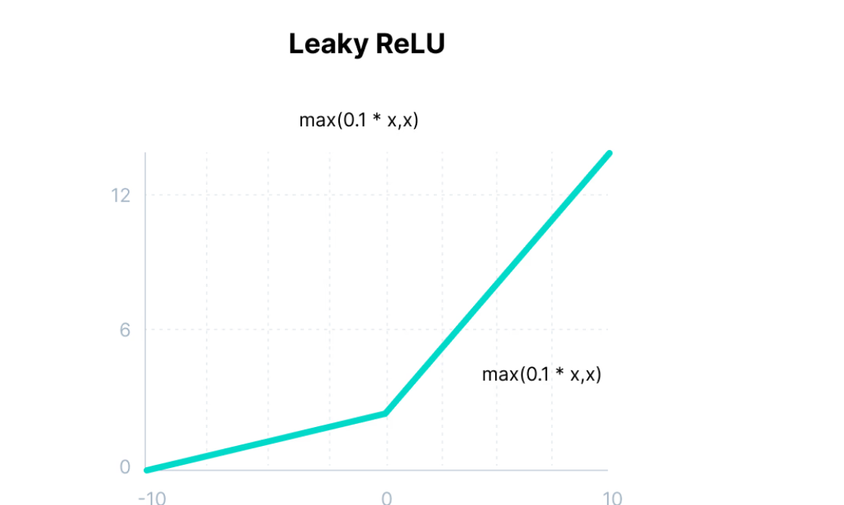
Leaky ReLU
It is an improved version of ReLU function to solve the Dying ReLU problem as it has a small positive slope in the negative area.

Slide 41
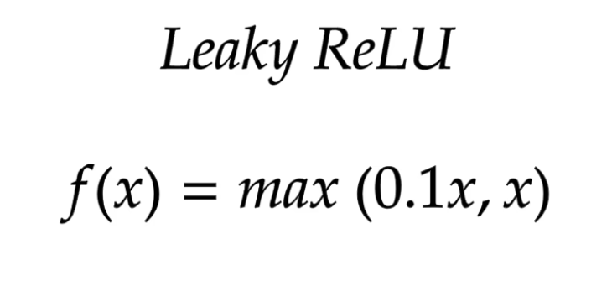
Leaky ReLU
Mathematically,
Advantages:
The advantages of Leaky ReLU are same as that of ReLU, in addition to the fact that it does enable backpropagation, even for negative input values.
By making this minor modification for negative input values, the gradient of the left side of the graph comes out to be a non-zero value. Therefore, we would no longer encounter dead neurons in that region.

Slide 42
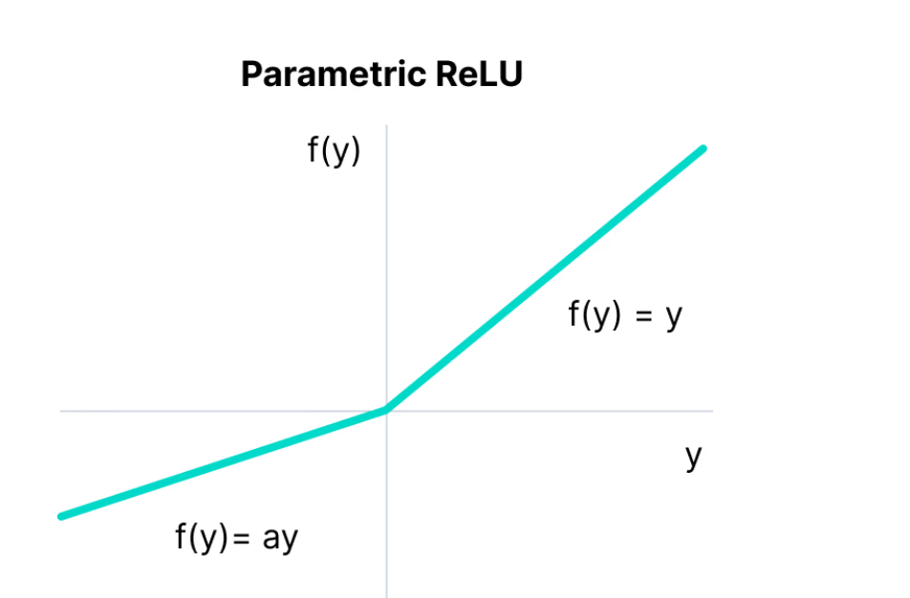
Parametric ReLU Function
Parametric ReLU is another variant of ReLU that aims to solve the problem of gradient’s becoming zero for the left half of the axis.
This function provides the slope of the negative part of the function as an argument a. By performing backpropagation, the most appropriate value of a is learnt.

Slide 43
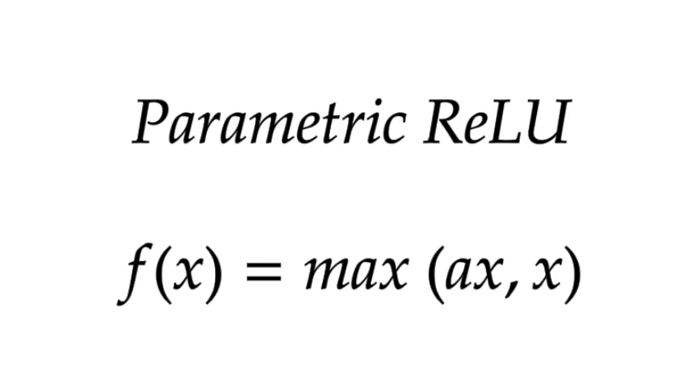
Parametric ReLU Function
Mathematically,
Where, a is the slope parameter for negative values.
The parameterized ReLU function is used when the leaky ReLU function still fails at solving the problem of dead neurons, and the relevant information is not successfully passed to the next layer.
This function’s limitation is that it may perform differently for different problems depending upon the value of slope parameter a.

Slide 44
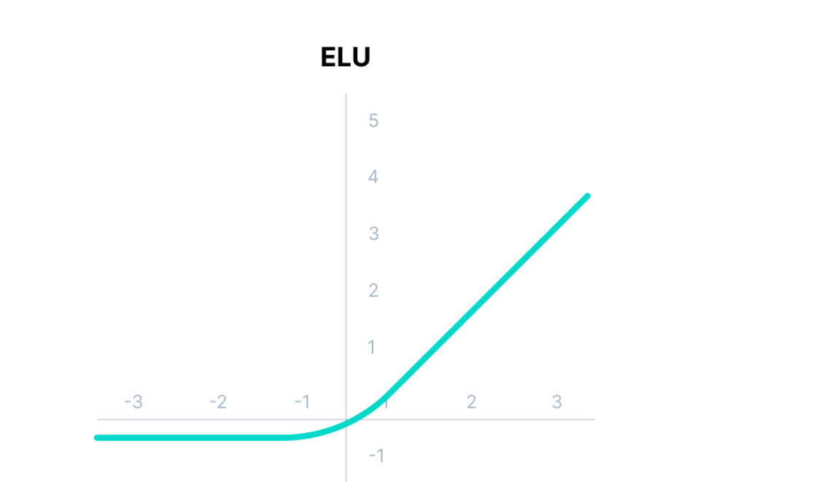
Exponential Linear Units (ELUs) Function
Exponential Linear Unit, or ELU for short, is also a variant of ReLU that modifies the slope of the negative part of the function.
ELU uses a log curve to define the negativ values unlike the leaky ReLU and Parametric ReLU functions with a straight line.

Slide 45
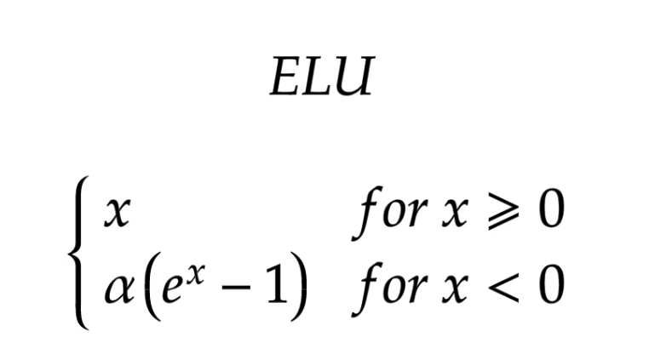
Exponential Linear Units (ELUs) Function
Mathematically,
Advantages:
ELU becomes smooth slowly until its output equal to -α whereas RELU sharply smoothes.
Avoids dead ReLU problem by introducing log curve for negative values of input. It helps the network nudge weights and biases in the right direction.
Limitations:
It increases the computational time because of the exponential operation included
No learning of the ‘a’ value takes place
Exploding gradient problem

Slide 46
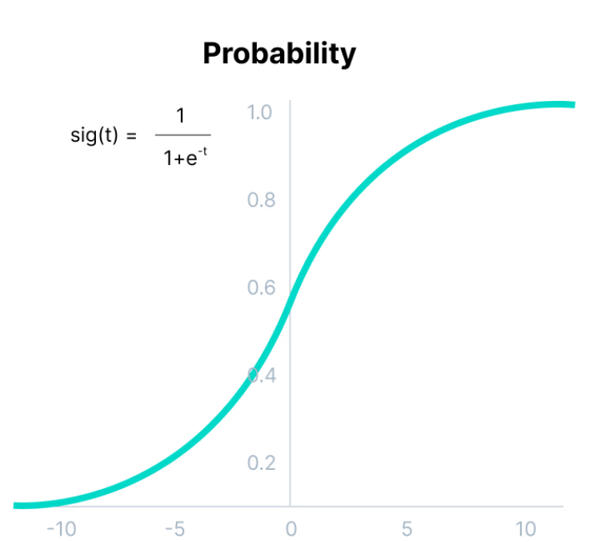
Softmax Function
the Softmax function is described as a combination of multiple sigmoids.
It calculates the relative probabilities. Similar to the sigmoid/logistic activation function, the SoftMax function returns the probability of each class.
It is most commonly used as an activation function for the last layer of the neural network in the case of multi-class classification.

Slide 47
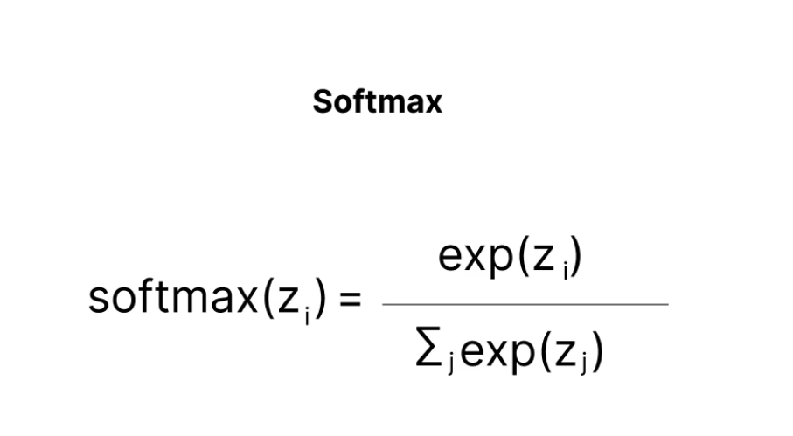
Softmax Function
Mathematically,
Example,
Assume that you have three classes, meaning that there would be three neurons in the output layer. Now, suppose that your output from the neurons is [1.8, 0.9, 0.68].
Applying the softmax function over these values to give a probabilistic view will result in the following outcome: [0.58, 0.23, 0.19].
The function returns 1 for the largest probability index while it returns 0 for the other two array indexes. Here, giving full weight to index 0 and no weight to index 1 and index 2. So the output would be the class corresponding to the 1st neuron(index 0) out of three.

Slide 48
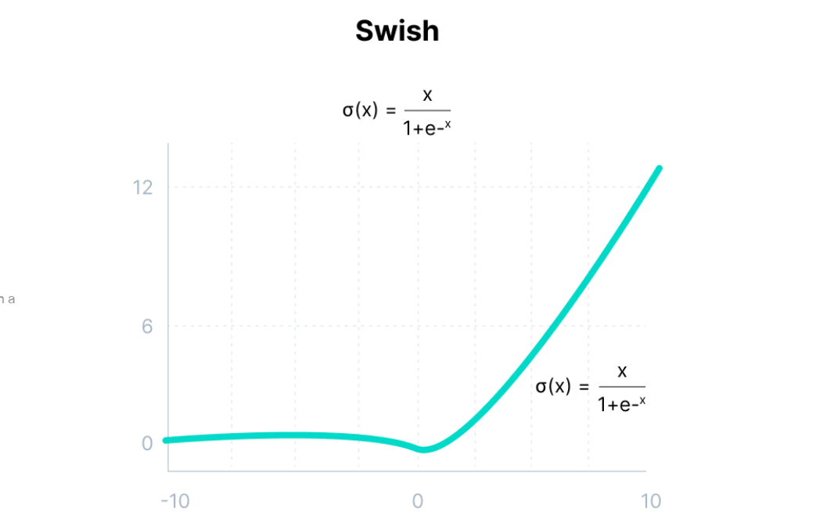
Swish Function
It is a self-gated activation function developed by researchers at Google.
Swish consistently matches or outperforms ReLU activation function on deep networks applied to various challenging domains such as image classification, machine translation etc.
This function is bounded below but unbounded above i.e. Y approaches to a constant value as X approaches negative infinity but Y approaches to infinity as X approaches infinity.

Slide 49
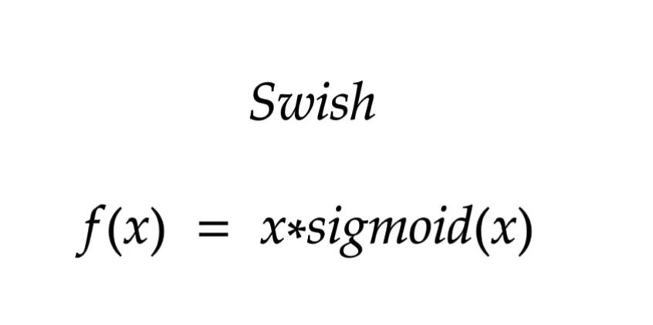
Swish Function
Mathematically,
Advantages:
Swish is a smooth function that means that it does not abruptly change direction like
ReLU does near x = 0. Rather, it smoothly bends from 0 towards values < 0 and then upwards again.
Small negative values were zeroed out in ReLU activation function. However, those negative values may still be relevant for capturing patterns underlying the data. Large negative values are zeroed out for reasons of sparsity making it a win-win situation.
The swish function being non-monotonous enhances the expression of input data and weight to be learnt.

Slide 50
The Gaussian Error Linear Unit (GELU)
The Gaussian Error Linear Unit (GELU) activation function is compatible with BERT, ROBERTa, ALBERT, and other top NLP models. This activation function is motivated by combining properties from dropout, zoneout, and ReLUs.
ReLU and dropout together yield a neuron’s output. ReLU does it deterministically by multiplying the input by zero or one (depending upon the input value being positive or negative) and dropout stochastically multiplying by zero.
RNN regularizer called zoneout stochastically multiplies inputs by one.
We merge this functionality by multiplying the input by either zero or one which is stochastically determined and is dependent upon the input. We multiply the neuron input x by m ∼ Bernoulli(Φ(x)), where Φ(x) = P(X ≤x), X ∼ N (0, 1) is the cumulative distribution function of the standard normal distribution.
This distribution is chosen since neuron inputs tend to follow a normal distribution, especially with Batch Normalization.
GELU nonlinearity is better than ReLU and ELU activations and finds performance improvements across all tasks in domains of computer vision, natural language processing, and speech recognition.

Slide 51
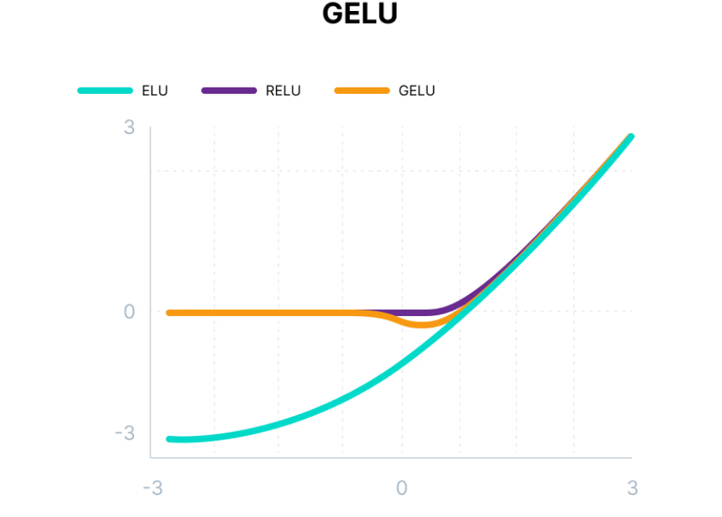
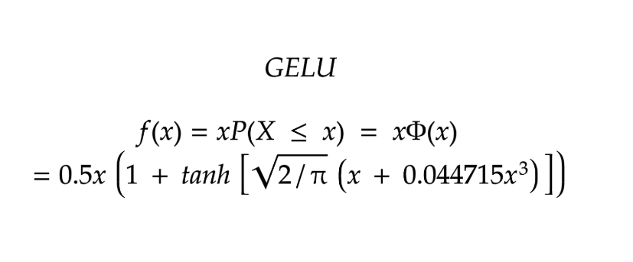
The Gaussian Error Linear Unit (GELU)
Mathematically,

Slide 52
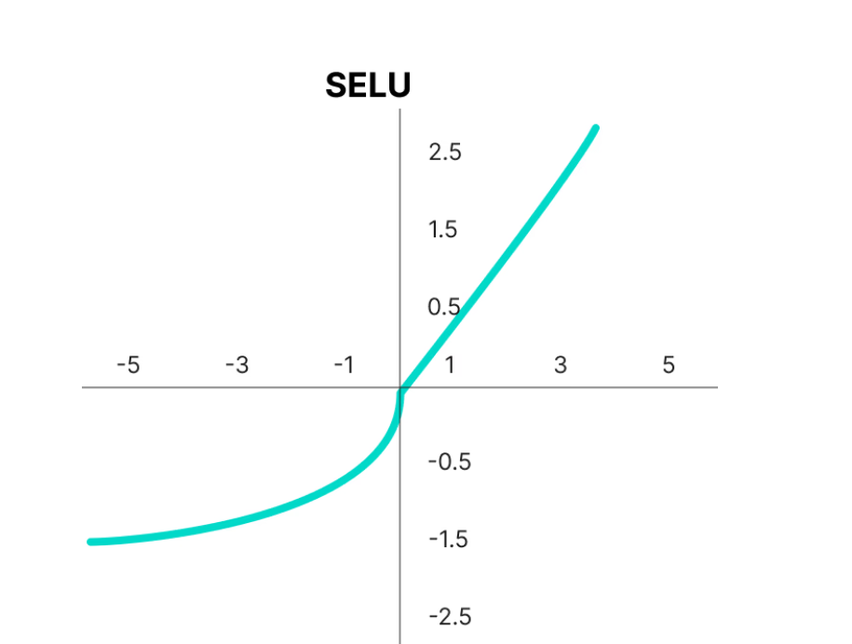
Scaled Exponential Linear Unit (SELU)
SELU was defined in self-normalizing networks and takes care of internal normalization which means each layer preserves the mean and variance from the previous layers. SELU enables this normalization by adjusting the mean and variance.
SELU has both positive and negative values to shift the mean, which was impossible for ReLU activation function as it cannot output negative values.
Gradients can be used to adjust the variance. The activation function needs a region with a gradient larger than one to increase it.

Slide 53
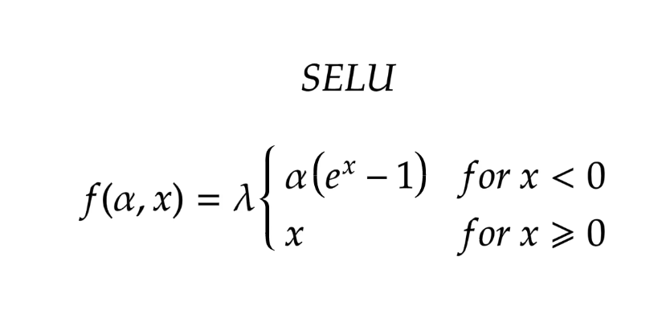
Scaled Exponential Linear Unit (SELU)
SELU has values of alpha α and lambda λ predefined.
Here’s the main advantage of SELU over ReLU:
Internal normalization is faster than external normalization, which means the network converges faster.
SELU is a relatively newer activation function and needs more papers on architectures such as CNNs and RNNs, where it is comparatively explored.

Slide 54
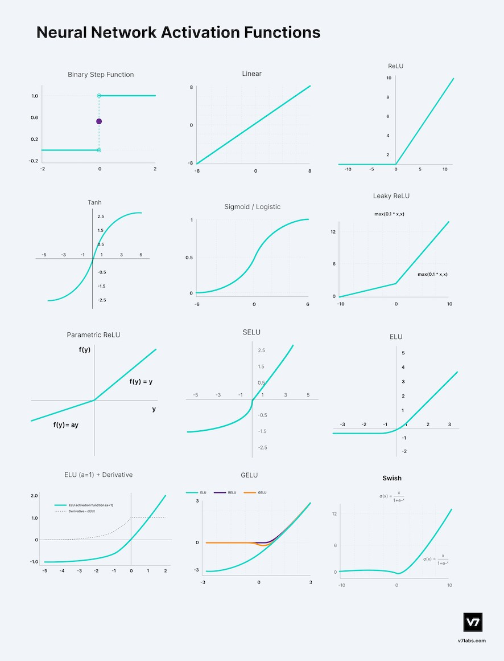
Types of Linear Activation Function

Slide 55
Choosing of Right Activation Function
The needed matching activation function for output layer based on the type of prediction problem that are solving—specifically, the type of predicted variable. For example,
As a rule of thumb, begin with using the ReLU activation function and then move over to other activation functions if ReLU doesn’t provide optimum results.
ReLU activation function should only be used in the hidden layers.
Sigmoid/Logistic and Tanh functions should not be used in hidden layers as they make the model more susceptible to problems during training (due to vanishing gradients).
Swish function is used in neural networks having a depth greater than 40 layers.
Regression - Linear Activation Function
Binary Classification—Sigmoid/Logistic Activation Function
Multiclass Classification—Softmax
Multilabel Classification—Sigmoid
Convolutional Neural Network (CNN): ReLU activation function.
Recurrent Neural Network: Tanh and/or Sigmoid activation function.

Slide 56
Weights in Neural Networks
Weights are numerical values associated with the connections between neurons. They determine the strength of these connections and, in turn, the influence that one neuron's output has on another neuron's input. Think of weights as the coefficients that adjust the impact of incoming data. They can increase or decrease the importance of specific information.
During the training phase of a neural network, these weights are adjusted iteratively to minimize the difference between the network's predictions and the actual outcomes. This process is akin to fine-tuning the network's ability to make accurate predictions.
Example: Suppose to building a neural network to recognize handwritten digits. Each pixel in an image of a digit can be considered an input to the network. The weights associated with each pixel determine how much importance the network places on that pixel when making a decision about which digit is represented in the image.
As the network learns from a dataset of labeled digits, it adjusts these weights to give more significance to pixels that are highly correlated with the correct digit and less significance to pixels that are less relevant. Over time, the network learns to recognize patterns in the data and make accurate predictions.

Slide 57
Biases in Neural Networks
Biases provide a critical additional layer of flexibility to neural networks. Biases are essentially constants associated with each neuron. Unlike weights, biases are not connected to specific inputs but are added to the neuron's output.
Biases serve as a form of offset or threshold, allowing neurons to activate even when the weighted sum of their inputs is not sufficient on its own. They introduce a level of adaptability that ensures the network can learn and make predictions effectively.
Example: Imagine a neuron that processes the brightness of an image pixel. Without a bias, this neuron might only activate when the pixel's brightness is exactly at a certain threshold. However, by introducing a bias, you allow the neuron to activate even when the brightness is slightly below or above the threshold.
This flexibility is crucial because real-world data is rarely perfectly aligned with specific thresholds. Biases enable neurons to activate in response to various input conditions, making neural networks more robust and capable of handling complex patterns.
During training, biases are also adjusted to optimize the network's performance. They can be thought of as fine-tuning parameters that help the network fit the data better.

Slide 58
Estimated model
After completing all the process using input variables, weights, adding bias, finding appropriate activation function, then finally find out estimated model.
After finding estimated model then do validity check.
And then forecast the results.
The output results may be classification, regression or clustering etc.

Slide 59
Backpropagation
Just as an estimation of regression coe cients using ordinary least squares, the weights in an ANN must be estimated. While there are several methods of training a network, the most successful and widely used is the feedforward, backpropagation method.
The method of propagating information about errors at the output layers back to hidden layers was discovered in the mid-1970s, but this method was either unknown or ignored. It was rediscovered in the 1980s and the method termed backpropagation was re ned and publicized by Devid Rumelhart and James McClelland (1986)

Slide 60
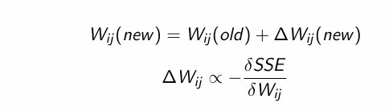
Backpropagation
If the neuron output functions are differentiable, then the adjustment of weights has a simple solution- adjust them in proportion to the negative of the change in the sum of squared errors with respect to the change in weights because of the behaviour of the slope of the SSE function.
That is,

Slide 61
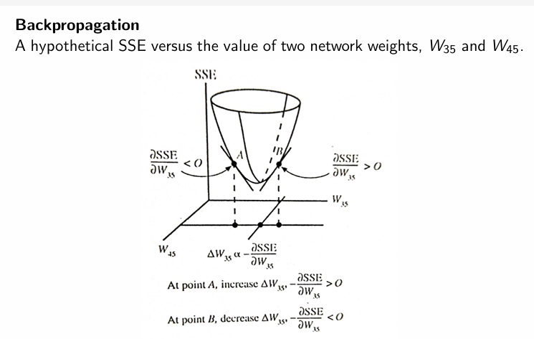
Backpropagation

Slide 62
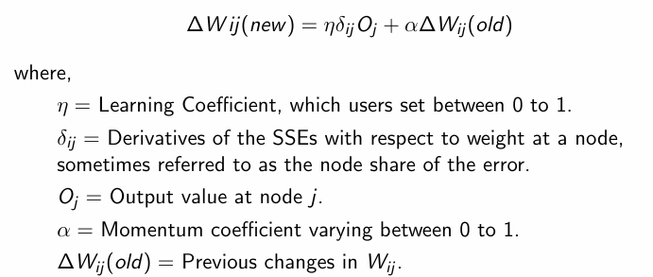
Backpropagation
In actuality, partial differentiation is used to change the weights in proportion to the derivative of the SSE with respect to weights. The training formula used in most software and the spreadsheets enclosed with this text use what is referred to as the Generalized Delta Rule.

Slide 63
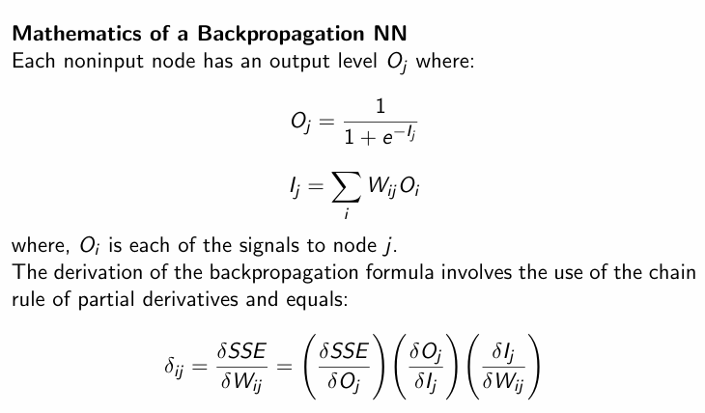
Backpropagation

Slide 64
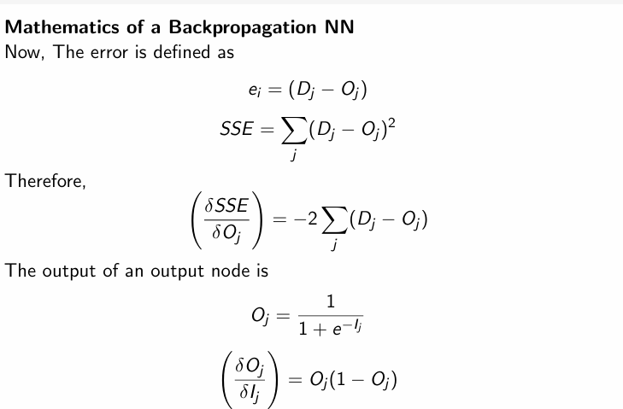
Backpropagation

Slide 65
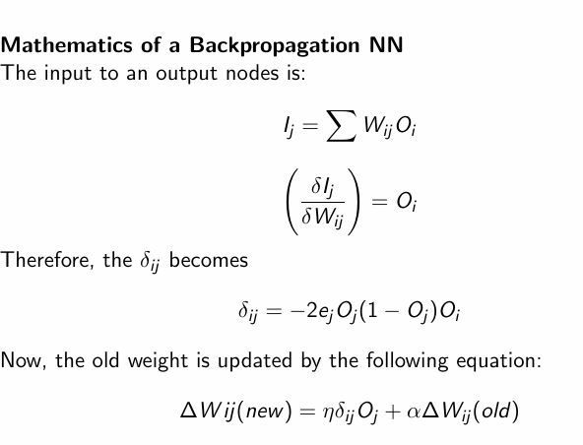
Backpropagation

Slide 66
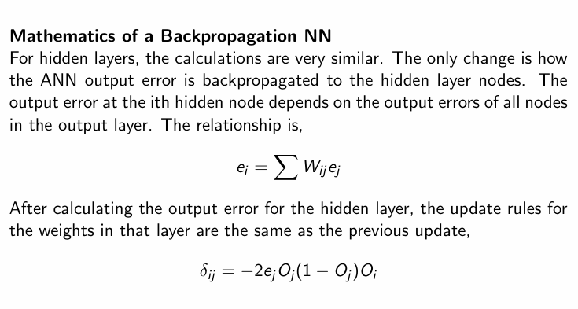
Backpropagation

Slide 67
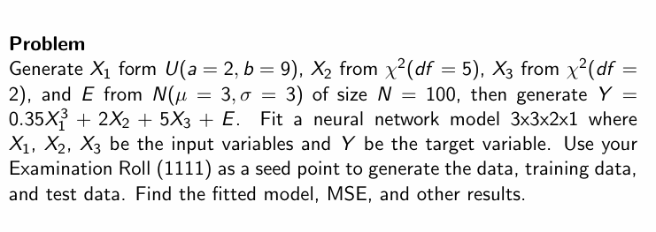
Practical Example

Slide 68
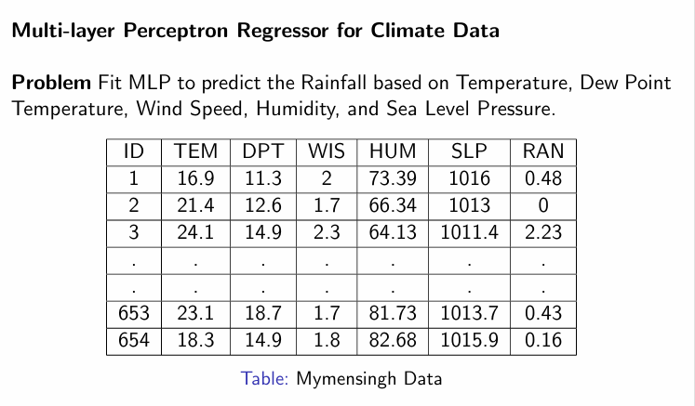
Practical Example

Slide 69
END

